Slide 1
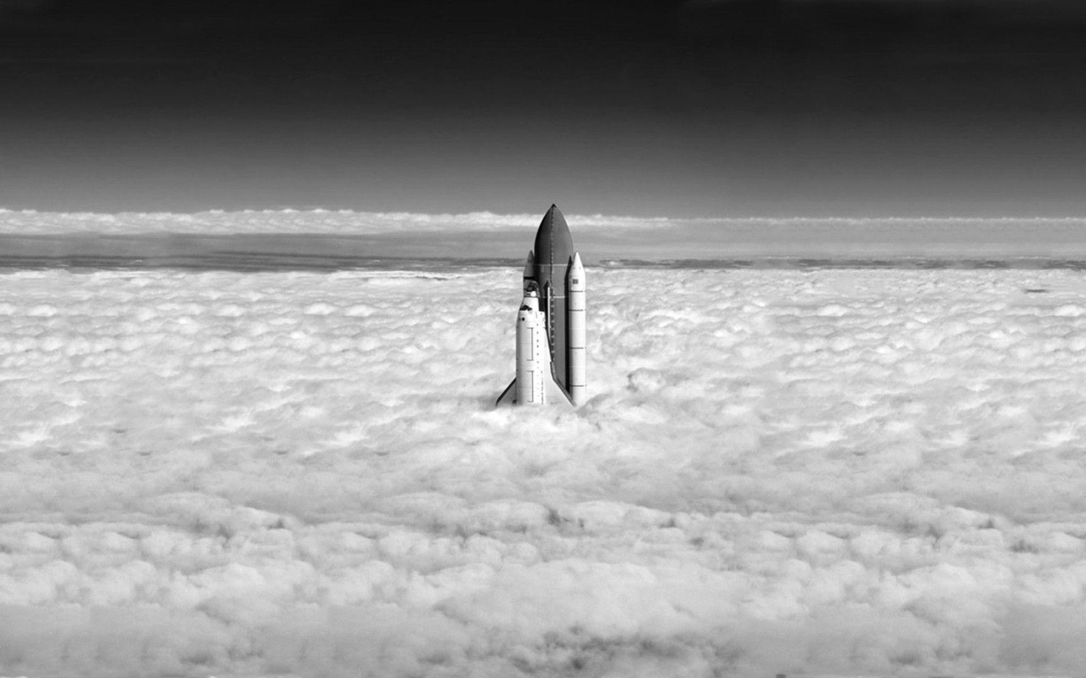
Click dice to keep
Player 1
Your first turn:
Resource
1
Resource
2
Resource
3
Resource
4
Resource
5
Build Phase
Re-Roll non-selected dice
Finish Turn
(Example choices)
Your choices:
Graphic for engine
Rocket pieces |  | Essential items
Engine |  | Crew Members
Mk1 |  | Fuel
Mk2 |  | Rocket Complete
Mk3 |  | This space is reserved for a graphic of the Player’s progress. (Work in progress)
Fuel Reserves
Mk1
Mk2
Mk3
Cockpit
Mk1
Mk2
Mk3
Graphic for fuel
Graphic for crew member

Slide 2
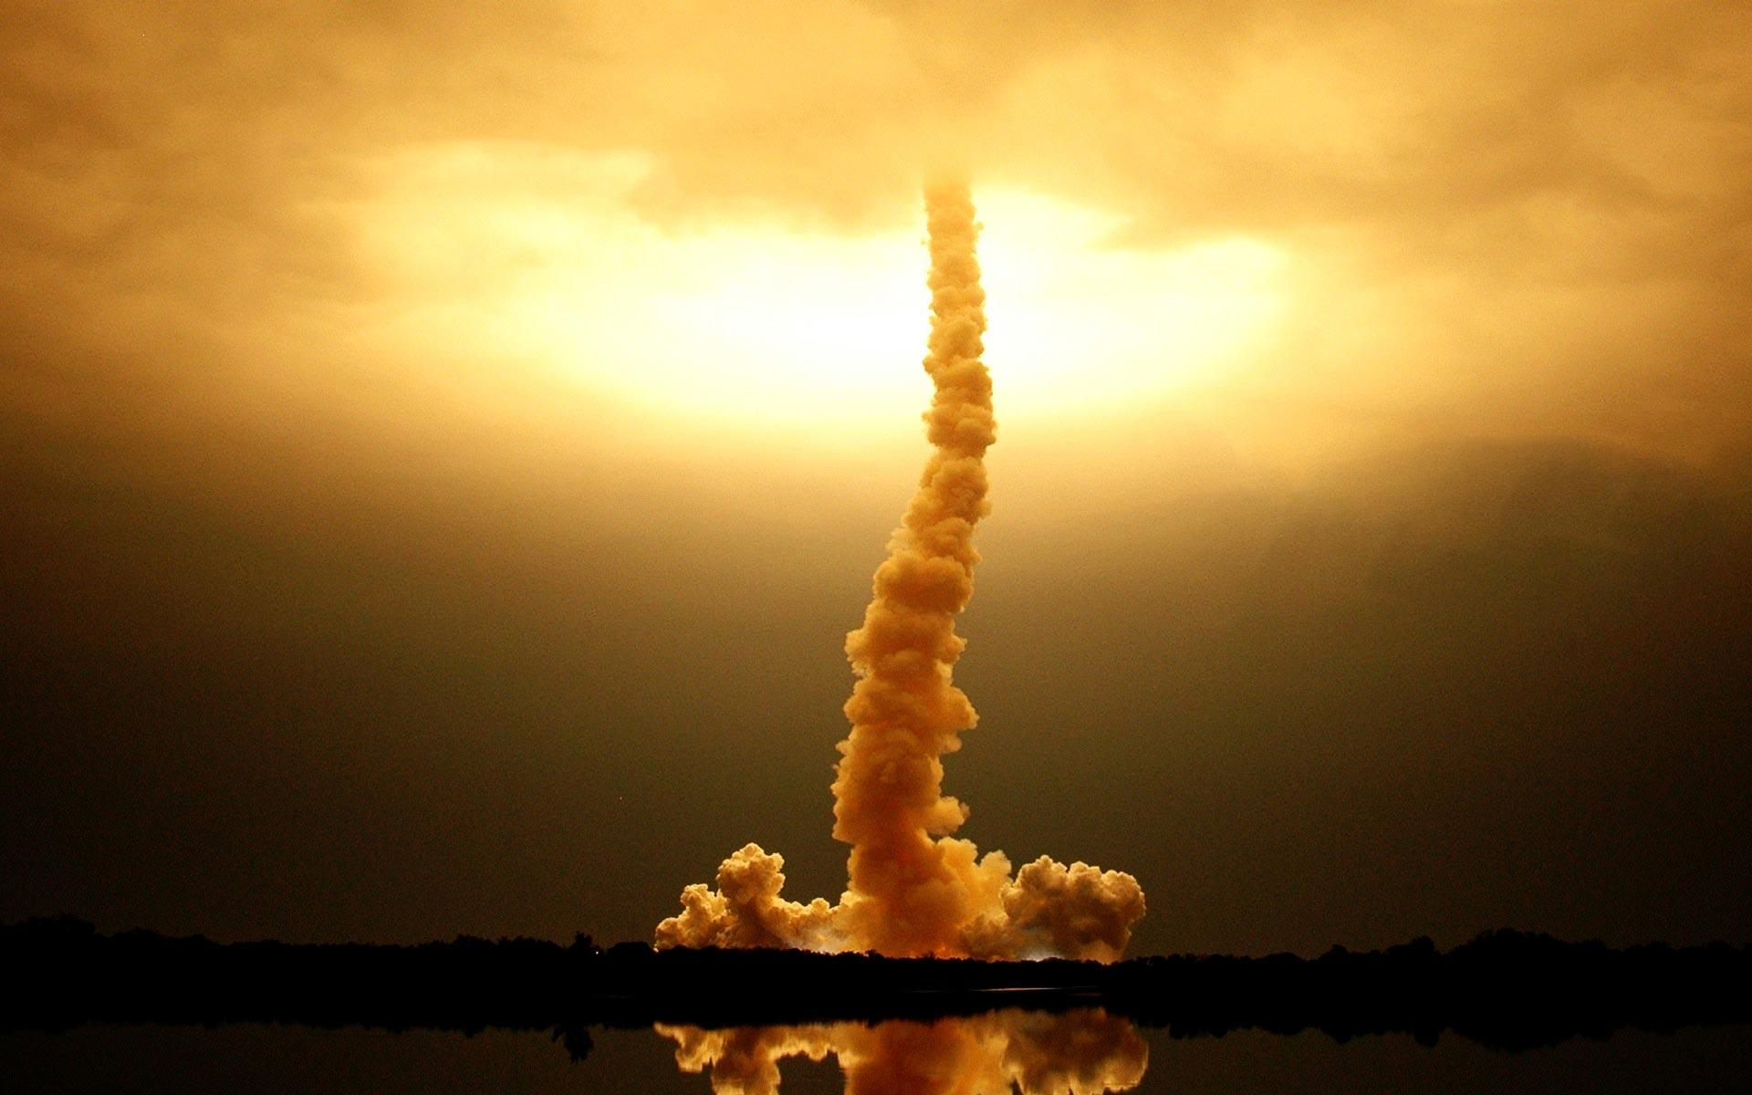
Space Phase
Quick reference:
Ahead fast: You will burn more fuel and go further, but there is a higher risk of an accident.
Ahead normal: You will burn a normal amount of fuel and have a normal risk of accident.
Ahead slow: You will burn less fuel and have a lower risk of accident, but go less far.
Current Positions
Player 1 | Player 2 | Player 3
Player 3’s turn
Current distance: 3
Current fuel left: 5
Make your choice:
Ahead fast
Ahead normal
Ahead
slow

